Slide 1
Classroom Allocation System
Team Hope
Michael Peter Jacky Alice

Slide 2
Design

Slide 3
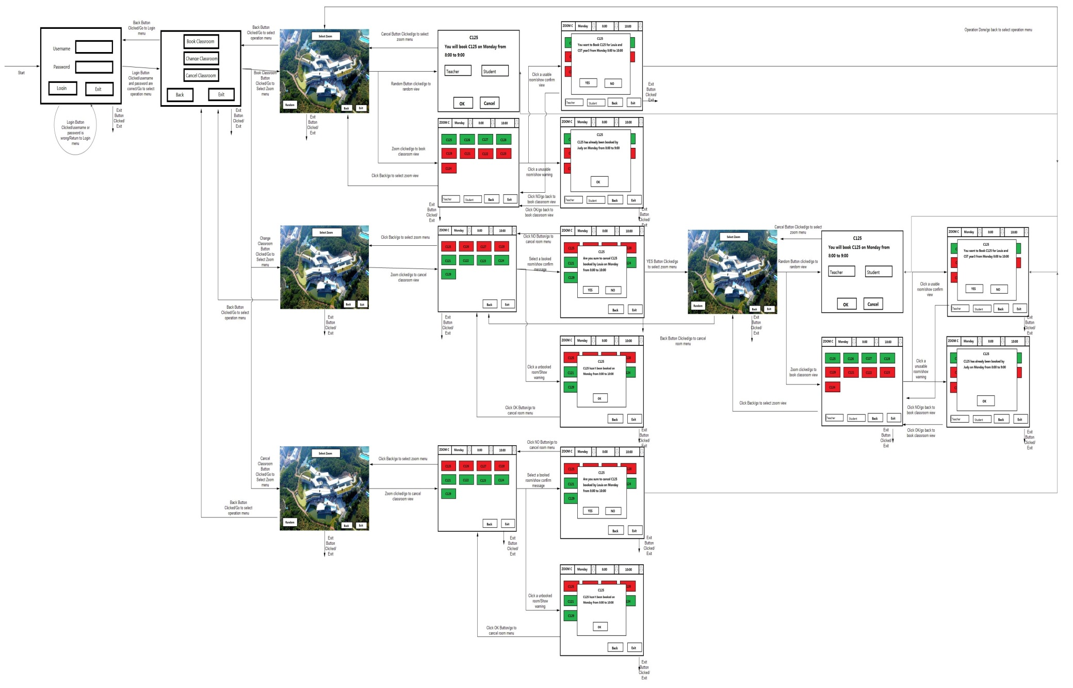
State transition Diagram
20 states
E0~ E19

Slide 4
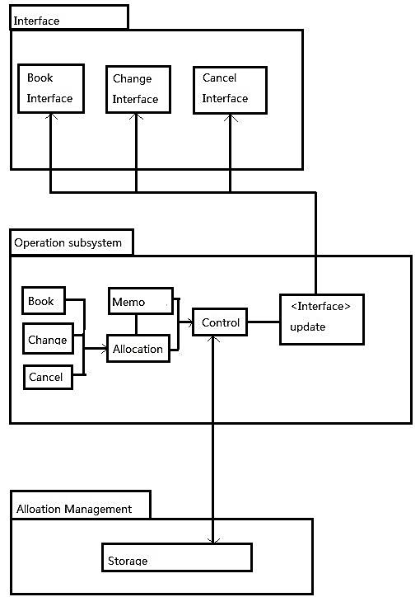
Architecture Design

Slide 5
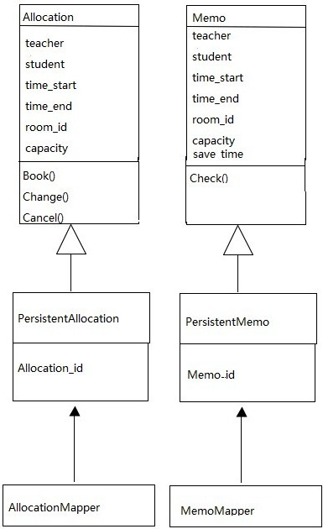
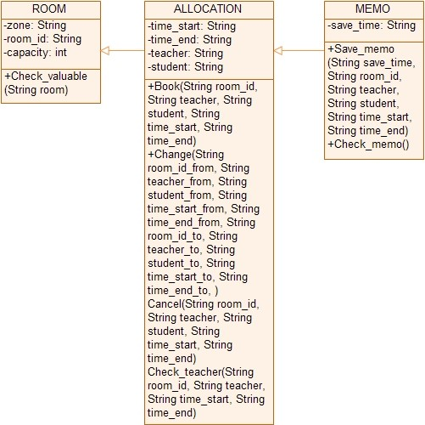
Detailed Design

Slide 6
Testing

Slide 7
Unit Testing
Configuration:
Microsoft Visual Studio 2010
Nunit 2.6 (Windows version)
VisualNunitPackage.vsix
Steps:
Click on a class
Choose “set Unit Testing”

Slide 8
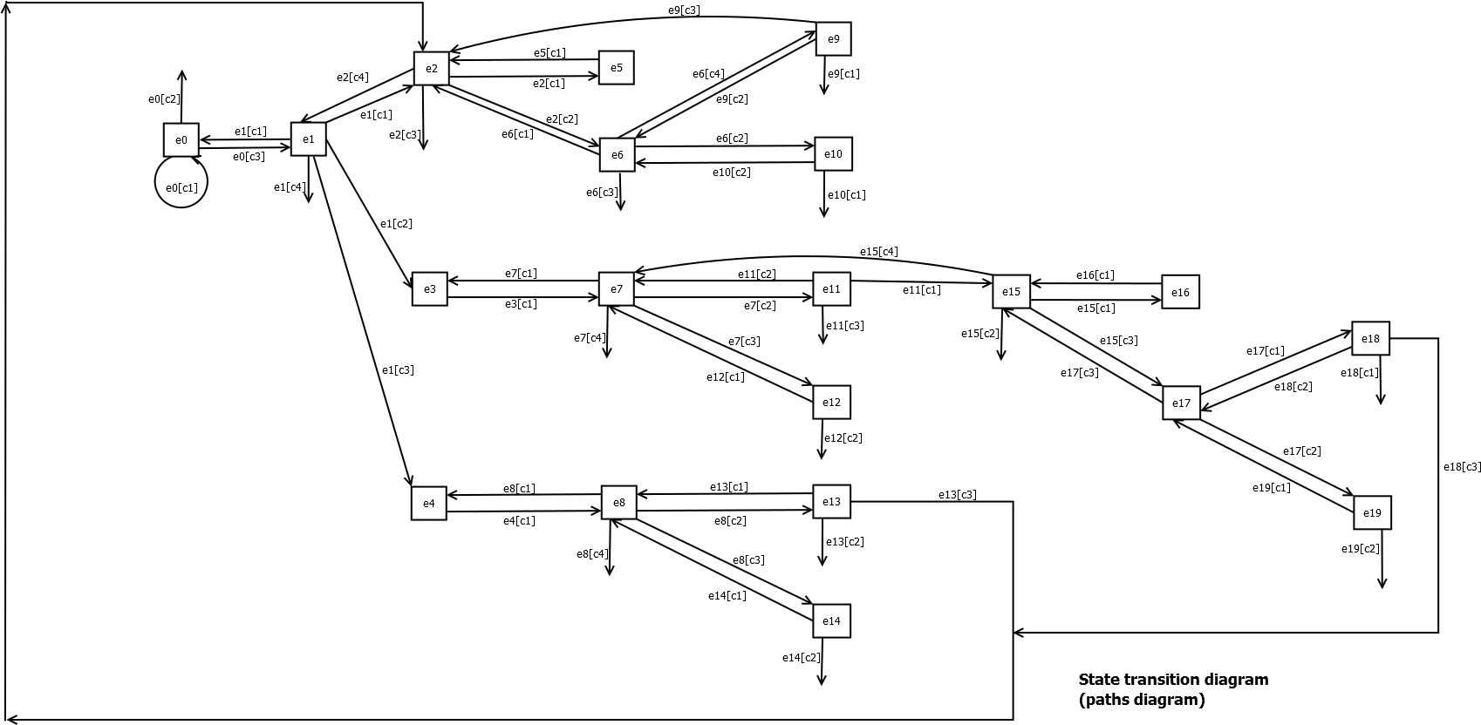
System Testing(Path)

Slide 9
Testcase(Booking)
id | Path | Expected result
 | e0[c3]->e1[c1]->e2[c1]->e5[c1] | BOOKING FAILURE
 | e0[c3]->e1[c1]->e2[c1]->e5[c2] | BOOKING SUCCESS
 | e0[c3]->e1[c1]->e2[c2]->e6[c1] | Back to option page
 | e0[c3]->e1[c1]->e2[c2]->e6[c2] | Show warning for unavailable booking
 | e0[c3]->e1[c1]->e2[c2]->e6[c2]->e10[c1] | EXIT from system
 | e0[c3]->e1[c1]->e2[c2]->e6[c2]->e10[c2] | Back to classroom information list
 | e0[c3]->e1[c1]->e2[c2]->e6[c3] | EXIT from system
 | e0[c3]->e1[c1]->e2[c2]->e6[c4]->e9[c1] | EXIT from system
 | e0[c3]->e1[c1]->e2[c2]->e6[c4]->e9[c2] | Booking denied
 | e0[c3]->e1[c1]->e2[c2]->e6[c4]->e9[c3] | Back to option page
 | e0[c3]->e1[c1]->e2[c3] | EXIT from system

Slide 10

Implementation
READY?
Now Loading…

Slide 11
The most
FANTASTIC
Classroom
Allocation
System
you ever seen!

Slide 12
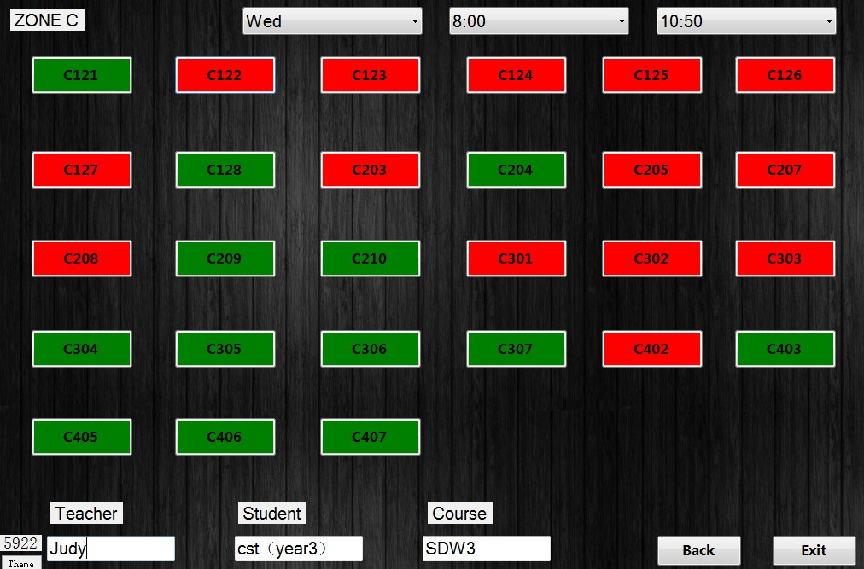
Leading Feature 1: Time-domain selection！
You want to book SDW3 for continuous 3 hours？NO PROBLEM!!!

Slide 13
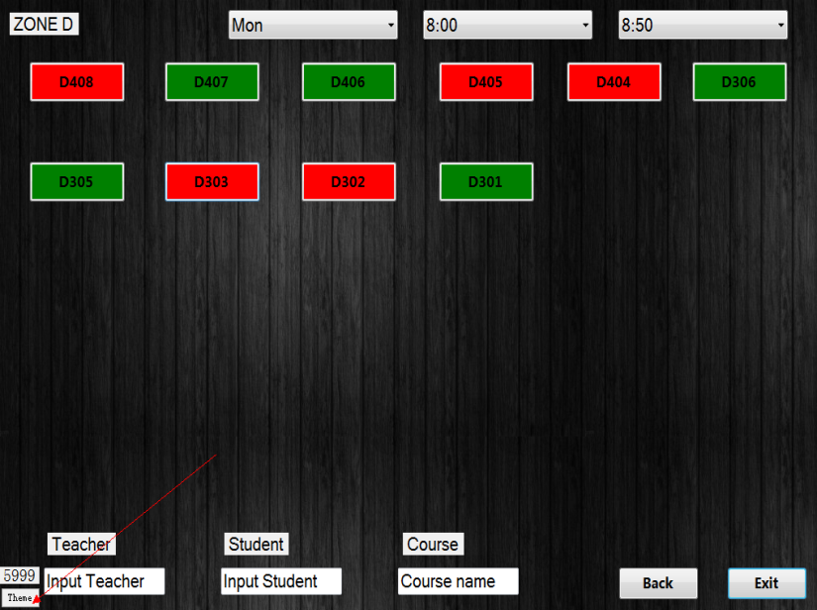
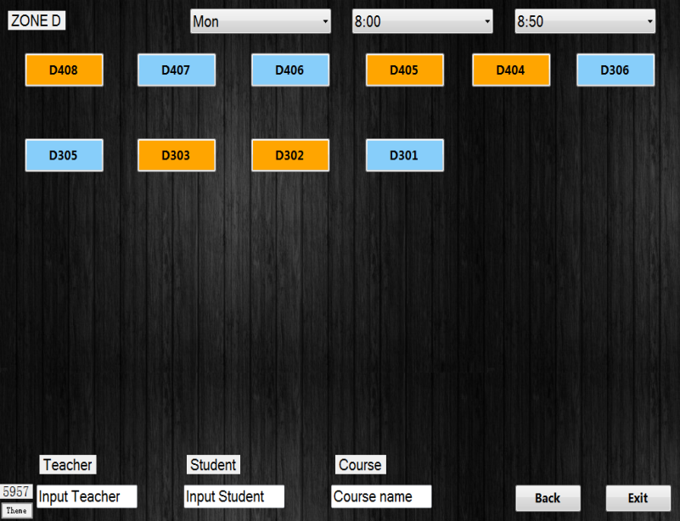
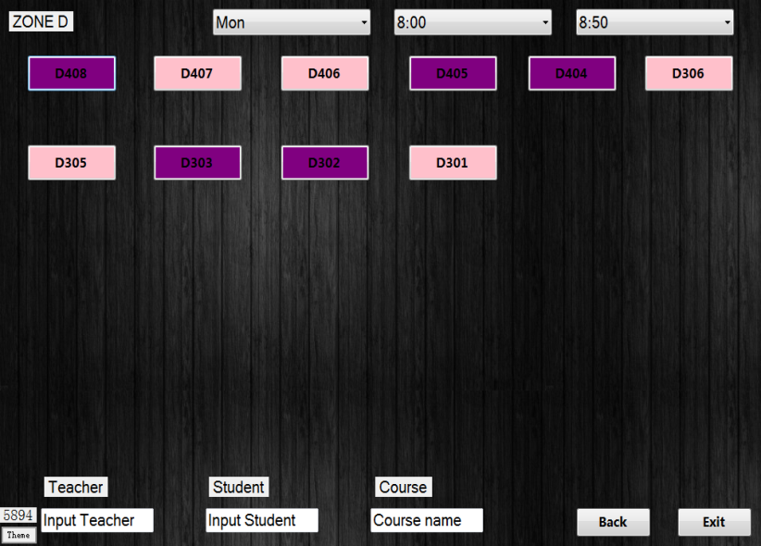
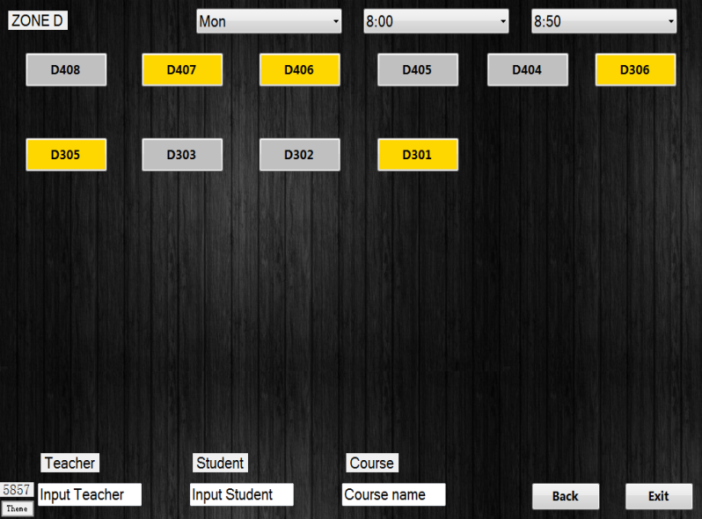
Leading Feature 2: One-Key theme changing
Just click one button then welcome to the new style!

Slide 14
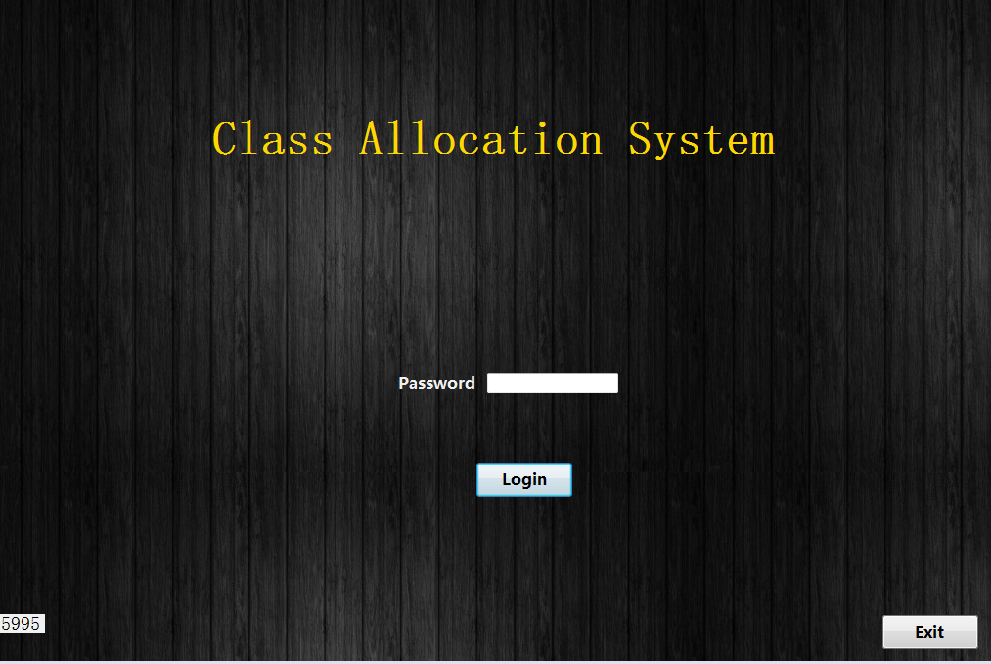
Leading Feature 3: Auto-logout
Do you always forget to log out the system?

Slide 15
Leading Feature 4:
compound storage structure
Combine the storage form of xls, xml and txt.
The legendary way to take control of the balance between effectiveness and efficiency

Slide 16
Time for a true display of demo

